Slide 1
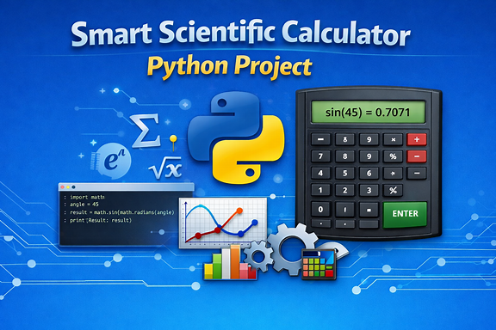


Slide 2
Introduction
A scientific calculator is an electronic device designed to perform both basic arithmetic and advanced mathematical operations such as trigonometric, logarithmic, exponential, and statistical functions. It is widely used in education, engineering, and scientific fields because it simplifies complex calculations that would otherwise require manual computation.

Slide 3
🔎 Key Characteristics of a Scientific Calculator
Basic Functions: Addition, subtraction, multiplication, division, square roots.
Advanced Functions:
Trigonometric (sin, cos, tan, and inverses)
Logarithmic (log base 10, ln)
Exponential functions (e^x, powers, roots)
Scientific notation for very large/small numbers
Memory & Programmability: Some models allow storing equations, variables, and even small programs.
Constants: Quick access to π and e.
Display: Modern calculators often have multi-line displays to show both input and output simultaneously.

Slide 4
Comparison: Basic vs. Scientific Calculator
Feature | Basic Calculator | Scientific Calculator
Arithmetic ( +, −, ×, ÷ ) | ✅ Yes | ✅ Yes
Square roots, powers | ❌ No | ✅ Yes
Trigonometric functions | ❌ No | ✅ Yes
Logarithms & exponentials | ❌ No | ✅ Yes
Statistical operations | ❌ No | ✅ Yes (some models)
Programmability | ❌ No | ✅ Some models
Display type | Single-line | Multi-line, advanced

Slide 5
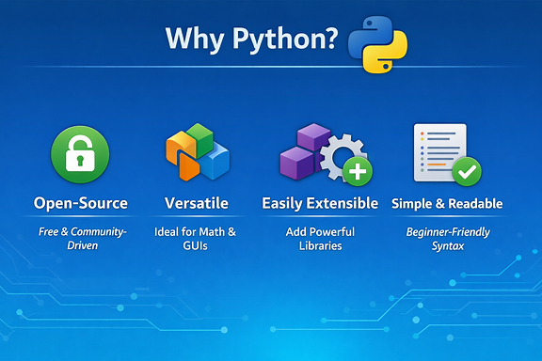
Why Python?
Open-source → Free to use, large community support.
Versatile → Handles math, data, GUI, and more.
Easy to extend → Add libraries (NumPy, SymPy, Tkinter) for advanced features.
Readable & simple → Beginner-friendly syntax, fast development.
Python is free, powerful, and flexible—perfect for building a smart scientific calculator.

Slide 6
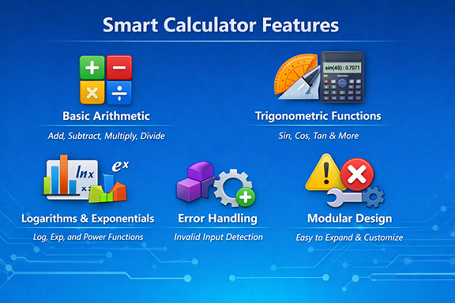
Features
➕ Basic arithmetic
📐 Trigonometric functions
📊 Logarithms & exponentials
🔒 Error handling
🔧 Modular design

Slide 7
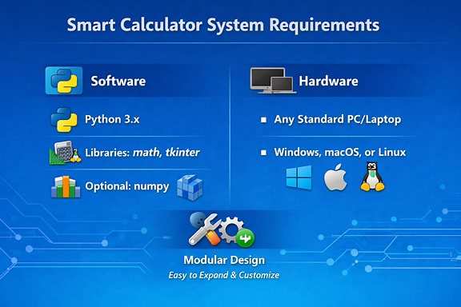
System Requirements
This slide clearly shows the two-column layout:
Left (Software):
Python 3.x
Libraries: math, tkinter, optional numpy
Python logo and code-related icons
Right (Hardware):
Any standard PC/laptop
Compatible with Windows, macOS, or Linux
Device and OS logos for visual clarity

Slide 8
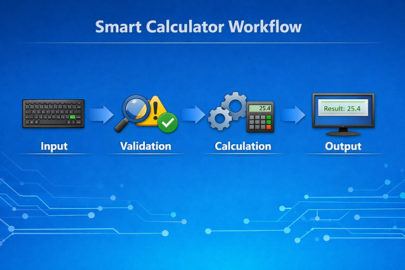
Workflow
Flowchart: Input → Validation → Calculation → Output
Layout: Horizontal arrows with small icons (keyboard → gear → screen).

Slide 9
Code Highlights
import math
def calculate(expression):
try:
return eval(expression, {"__builtins__": None}, math.__dict__)
except Exception as e:
return f"Error: {e}"
Caption: Safe evaluation using math module

Slide 10
Advantages
✅ Open-source & Customizable
✅ Lightweight & Portable
✅ Educational Value
✅ Easy To Extend

Slide 11
Limitations
⚠️ Basic GUI compared to commercial calculators
⚠️ Requires Python setup
⚠️ Limited to implemented functions

Slide 12
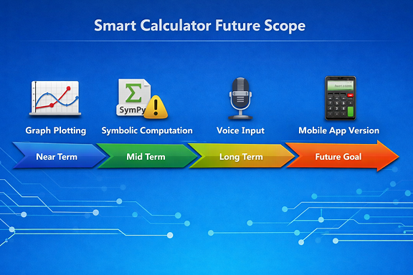
Future Scope
📈 Graph plotting
🧮 Symbolic computation (SymPy)
🎤 Voice input
📱 Mobile app version
Layout: Timeline graphic or roadmap arrows.

Slide 13
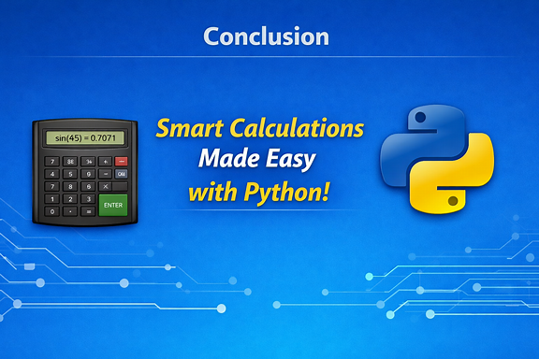
Conclusion
Python makes scientific computing simple & scalable
Useful for students, engineers, researchers
Foundation for advanced computational tools
Layout: Bold closing statement + calculator + Python logo.

Slide 14


